Slide 1
DATA FLOW DIAGRAMS

Slide 2
Key Definitions
Process model
  A formal way of representing how a business operates
  Illustrates the activities that are performed and how data moves among them
Data flow diagramming
  A popular technique for creating process models

Slide 3
Key Definitions
Logical process models describe processes without suggesting how they are conducted
Physical process models include process implementation information

Slide 4
DFD Elements
Process
  An activity or function performed for a specific business reason
  Manual or computerized
Data flow
  A single piece of data or a logical collection of data
  Always starts or ends at a process

Slide 5
DFD Elements
Data Store
  A collection of data that is stored in some way
  Data flowing out is retrieved from the data store
  Data flowing in updates or is added to the data store
External entity
  A person, organization, or system that is external to the system but interacts with it.

Slide 6
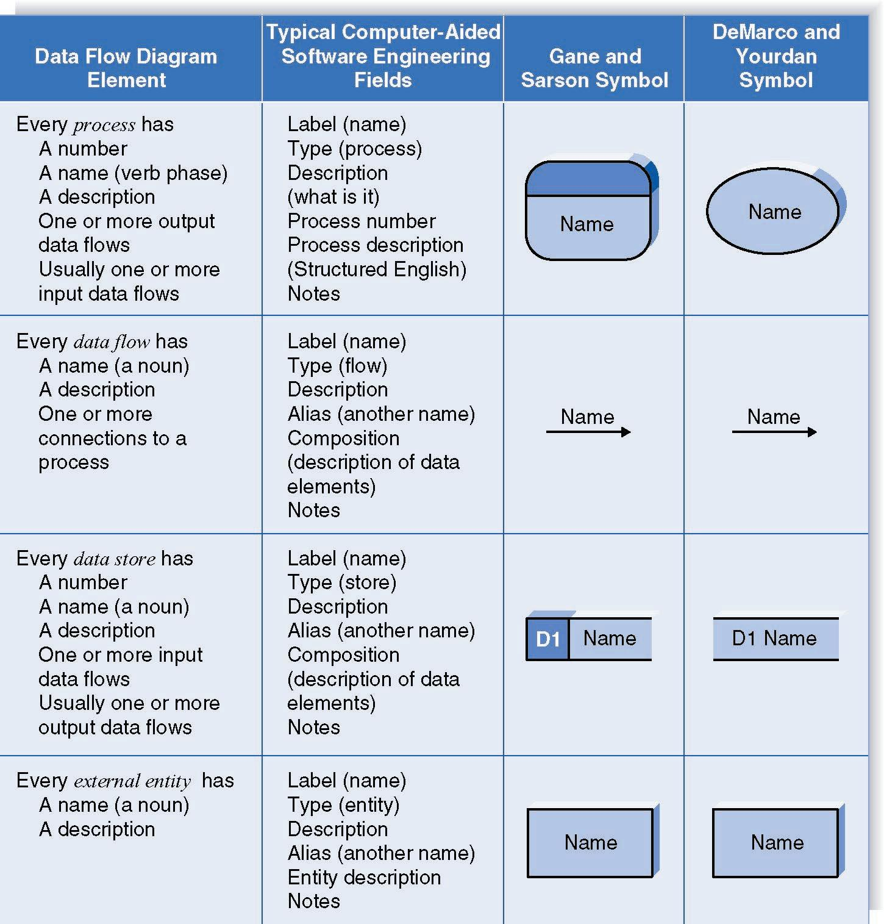
Naming and Drawing DFD Elements
Process
Data flow
Data store
External
entity

Slide 7
Key Definition
Balancing involves insuring that information presented at one level of a DFD is accurately represented in the next level DFD.

Slide 8
Context Diagram
First DFD in every business process
Shows the context into which the business process fits
Shows the overall business process as just one process (process 0)
Shows all the external entities that receive information from or contribute information to the system

Slide 9
Level 0 Diagram
Shows all the major processes that comprise the overall system – the internal components of process 0
Shows how the major processes are interrelated by data flows
Shows external entities and the major processes with which they interact
Adds data stores

Slide 10
Level 1 Diagrams
Generally, one level 1 diagram is created for every major process on the level 0 diagram
Shows all the internal processes that comprise a single process on the level 0 diagram
Shows how information moves from and to each of these processes
If a parent process is decomposed into, for example, three child processes, these three child processes wholly and completely make up the parent process

Slide 11
Level 2 Diagrams
Shows all processes that comprise a single process on the level 1 diagram
Shows how information moves from and to each of these processes
Level 2 diagrams may not be needed for all level 1 processes
Correctly numbering each process helps the user understand where the process fits into the overall system

Slide 12
Data Flow Diagrams
DFDs are one of the main methods available for analyzing data-oriented systems.
DFDs emphasize the logic underlying the system.
The systems analysts can put together a graphical representation of data movement through the organization.

Slide 13
Advantages of the Data Flow Diagram Approach
Four advantages over narrative explanations of data movement:
  Freedom from committing to the technical implementation too early.
  Understanding of the interrelationships of systems and subsystems.
  Communicating current system knowledge to users.
  Analysis of the proposed system.

Slide 14
Basic Symbols
Four basic symbols are:
  A double square for an external entity--a source or destination of data.
  An arrow for movement of data from one point to another.
  A rectangle with rounded corners for the occurrence of transforming process.
  An open-ended rectangle for a data store.

Slide 15
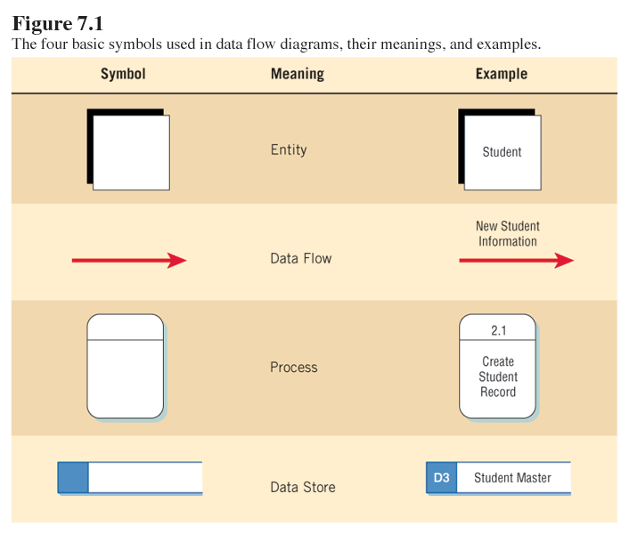
Basic Symbols

Slide 16

External Entities
Represent people or organizations outside of the system being studied
Shows the initial source and final recipient of data and information
Should be named with a noun, describing that entity

Slide 17
External Entities (Continued)
External entities may be:
  A person, such as CUSTOMER or STUDENT.
  A company or organization, such as BANK or SUPPLIER.
  Another department within the company, such as ORDER FULFILLMENT.
  Another system or subsystem, such as the INVENTORY CONTROL SYSTEM.

Slide 18

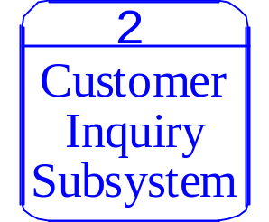
Processes
Represent either:
  A whole system
  A subsystem
  Work being done, an activity
Names should be in the form verb-adjective-noun
  The exception is a process that represents an entire system or subsystem.

Slide 19

Data Stores
Name with a noun, describing the data
Data stores are usually given a unique reference number, such as D1, D2, D3.
Include any data stored, such as:
  A computer file or database.
  A transaction file .
  A set of tables .
  A manual file of records.

Slide 20


Data Flow
Data flow shows the data about a person, place, or thing that moves through the system.
Names should be a noun that describes the data moving through the system.
Arrowhead indicates the flow direction.
Use double headed-arrows only when a process is reading data and updating the data on the same table or file.

Slide 21
Developing Data Flow Diagrams
Use the following guidelines:
  Create the context level diagram, including all external entities and the major data flow to or from them.
  Create Diagram 0 by analyzing the major activities within the context process.
    Include the external entities and major data stores.
  Create a child diagram for each complex process on Diagram 0.

Slide 22
Creating Data Flow Diagrams
Detailed data flow diagrams may be developed by:
  Making a list of business activities.
  Analyzing what happens to an input data flow from an external entity.
  Analyzing what is necessary to create an output data flow to an external entity.

Slide 23
Data Flow Diagram Levels
Data flow diagrams are built in layers.
The top level is the Context level.
Each process may explode to a lower level.
The lower level diagram number is the same as the parent process number.
Processes that do not create a child diagram are called primitive.

